Slide 1
Garde Manger
Day 4: Cheese

Slide 2
Learning Objectives
Define what cheese is and trace its history.
List the basic steps of cheesemaking.
Identify the most common varieties of cheese.
Understand the principles of cheese service and cheese pairings.
Learn how to put a contemporary spin on traditional hors d’oeuvre selections.
Practice creative presentation techniques suitable for buffet/ banquet operations.
Produce the assigned hot and cold canapés and cheese platters.

Slide 3
Key Terms
Acidification
Bacteria
Blue-Veined
Brine
Butterfat
Ferment
Coagulation
Culture
Curd
Enzyme (Rennet)
Mold
Pasta-Filata
Pasteurization
Rind
Ripen
Whey
Yeast

Slide 4
What is Cheese?
Dairy product made by fermenting milk and draining off excess liquid
Most made with four basic ingredients: milk, cultures, enzymes, and salt
Most aged for weeks, months, or years
Hundreds of types of cheese in wide-ranging flavors, textures, and forms
Flavor: mild and sweet to savory and nutty to funky and pungent
Texture: soft and spreadable, creamy and smooth, or firm and crumbly
Factors Affecting Style, Texture, and Flavor:
Origin of the milk (and animal's diet)
Pasteurization
Butterfat Content,
Bacteria and Mold
Processing
Aging

Slide 5
What is Cheese?
Milk: the main ingredient, usually cow’s milk (goats, sheep, buffalo, and even camels also used)
Cultures: beneficial bacteria, molds, and yeasts; ferment the milk; give each style its unique flavor and texture.
Enzymes (rennet): transforms liquid milk into solid curd by milk casein proteins that stick to each other
Salt: enhances flavor, affects texture, helps regulate microbes and enzymes as the cheese ripens; A natural preservative
Flavoring: brine, spices, herbs, and wine.

Slide 6
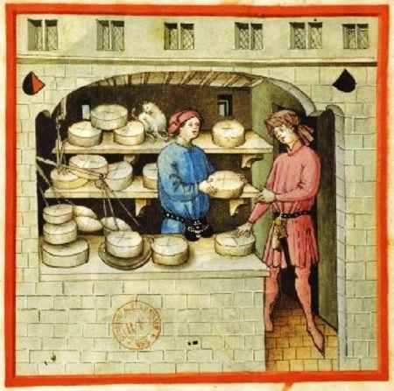
Cheese History
From the Latin word caseus “to ferment, become sour”
First discovered around 8000 B.C.; sheep stomachs, used to carry milk, contain an enzyme that curdled milk, creating cheese
The Romans enjoyed wide variety of cheeses; cheesemaking considered an art form
Most named cheeses discovered in late Middle Ages
First mass production of cheese in 1815
Scientists mass-produced rennet in 1860s and pure microbial cultures in 1900, allowing cheese to be standardized

Slide 7
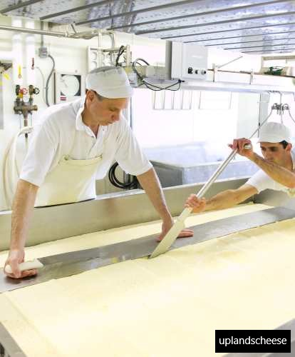
Basic Steps of Cheesemaking
Acidification: a starter culture is added to milk that changes lactose into lactic acid; begins process of turning milk from liquid to solid
Coagulation: process of transforming the liquid into a semisolid; enzyme (rennet) is added to further encourage the milk to solidify
Curds and Whey: As milk solidifies, it forms curd (solids) and whey (liquid). The curds are cut, which encourages them to expel whey. The smaller the curds are cut, the harder the resulting cheese will be. Lastly, the whey is drained away.

Slide 8
Basic Steps of Cheesemaking
Salting: Salt is added for flavor. It also acts as a preservative and helps to form a natural rind.
Shaping: Each type of cheese takes its familiar form as a solid block or wheel; cheese put into a basket or a mold to form it into a specific shape; Cheese is also pressed with weights or a machine to expel any remaining liquid.
Ripening: Cheese is aged until it reaches optimal ripeness. Temperature and humidity is closely monitored. For some cheeses, ambient molds in the air give the cheese a distinct flavor. For others, mold is introduced by spraying it on the cheese or injecting it into the cheese. Some cheeses must be turned, some must be brushed with oil, and some must be washed with brine or alcohol.

Slide 9
Varieties of Cheese
Variety | Description | Examples
Soft-Fresh | unripened; fresh, clean, creamy flavor; the most perishable | cottage cheese, goat’s milk, cream cheese
Soft-Ripened | sprayed or dusted with a mold and allowed to ripen | Brie, Camembert
Semi-Soft | in-between a soft and hard cheese | fontina, halloumi, Gouda Monterey Jack
Rind-Ripened | washed with brine, beer, cider, wine, brandy, or oils during ripening, encouraging bacterial growth | Limburger, Liederkranz, Muenster, Saint Paulin
Dry-Rind | allowed to form a natural rind during ripening | Bel Paese, Havarti
Waxed-Rind | sealed in wax before the aging process | Gouda, Edam

Slide 10
Varieties of Cheese
Variety | Description | Examples
Blue-Veined | holed to allow gasses to escape and oxygen to enter, supporting mold growth; salted or brined and allowed to ripen in caves | Roquefort, Gorgonzola, Stilton, Maytag blue
Pasta-Filata | curds dipped into hot water, then stretched or spun until the proper consistency and texture is achieved; Then kneaded and molded into the desired shapes | Mozzarella, provolone
Hard | moisture content lower than 50%; cheese allowed to age by pressing the curds to separate the whey | Cheddar, Swiss
Very Hard | known as the “granas” (from the Italian word for grain), because of their granular texture | Parmesan, Romano

Slide 11
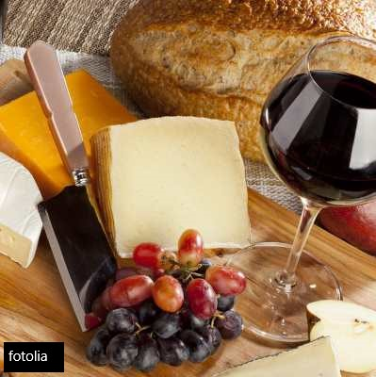
Cheese Pairings
Three types of foods have a natural affinity for cheese:
Wine: contrasts with the richness of cheese; its acidity cuts through the butterfat
Beer: contrasts with the saltiness of cheese
Bread and Crackers: probably the original partner to cheese
Fruit: sweet juiciness pairs well with the earthy richness of cheeses

Slide 12
Developing a Cheese Board
Select cheeses based on color, shape, texture, richness, and intensity
A modest selection might offer a single cheese from the soft, blue, and hard categories
More extensive boards could expand sections within categories or feature a selection of regional favorites
A flight of cheeses offers a chance to taste and compare a variety of cheeses made from the same main ingredient
To bring out the fullest flavor, allow cheese to come to room temperature before service
Wooden cheese boards, service platters, mirrors, or marble are eye-catching items for cheese board service

Slide 13
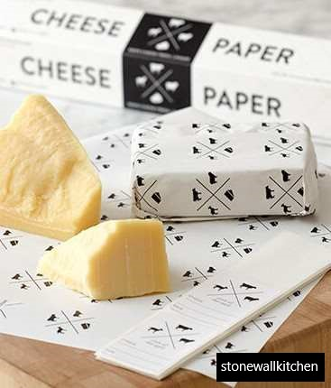
Cheese Storage
Ideal temperature for storing most cheese: 42-50°F
Need for humidity varies, but most do well at 65%
Cheese is a living thing-- It sweats, ages, breathes
Cut cheese must be protected both from drying out and from getting too little air
Cheese or parchment paper allows it to breathe but also contains some of its moisture for freshness
Plastic wrap can suffocate cheese, resulting in an ammoniac flavor and possibly harmful bacteria

Slide 14
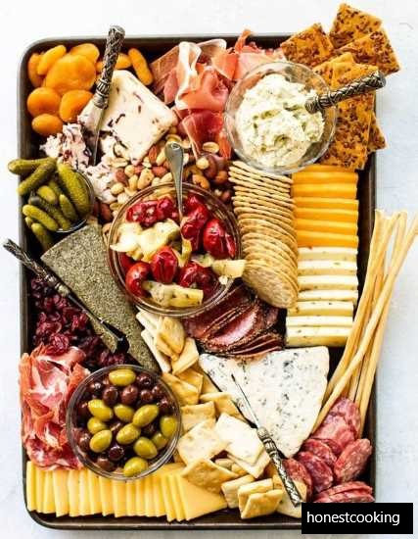
Platters: Presentation and Layout
To produce a pleasing physical layout, remember to consider the following:
Balance
Focal Point
Visual Lines
Flow and Sequencing
Unity
Height
Shape
Color
Texture

Slide 15
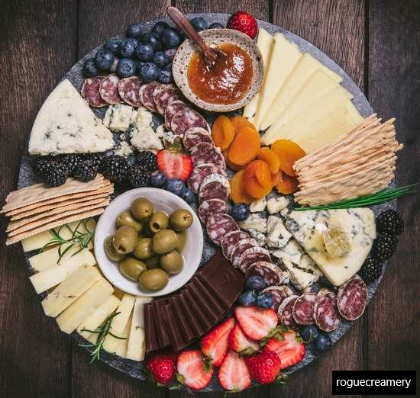
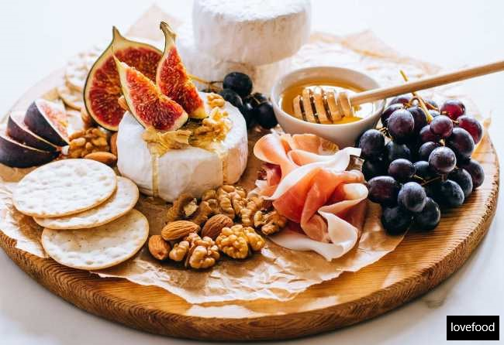
Platters

Slide 16
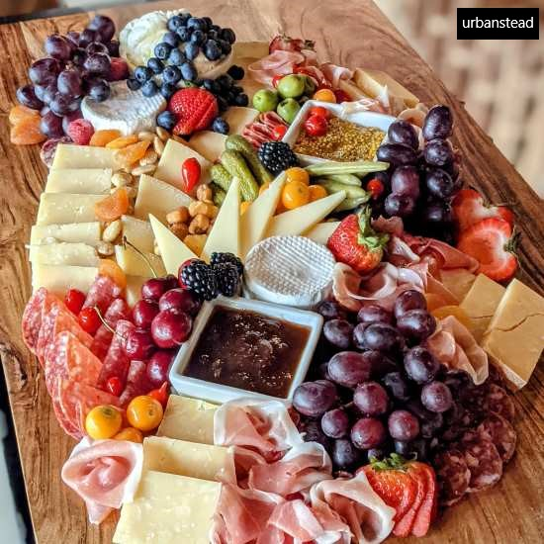
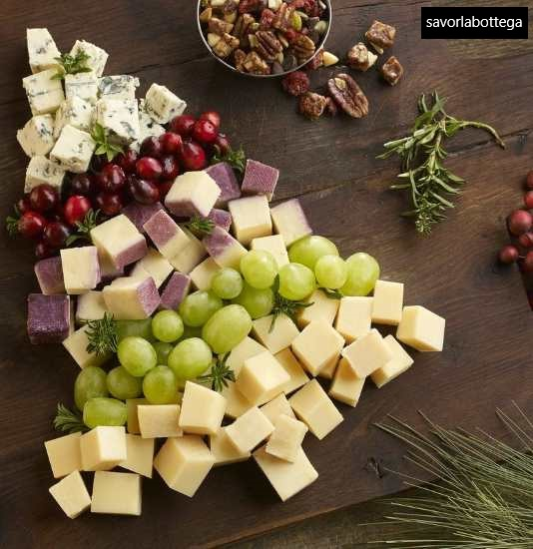
Platters

Slide 17
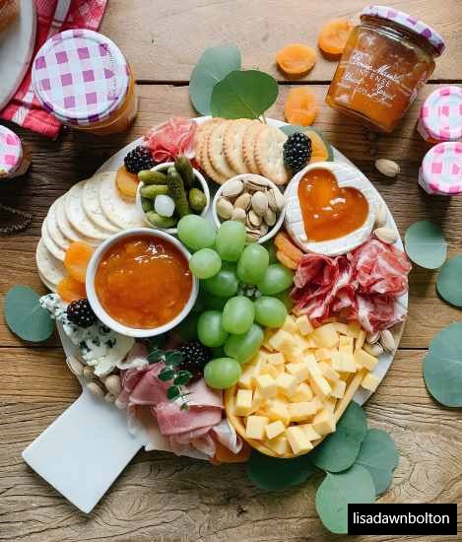
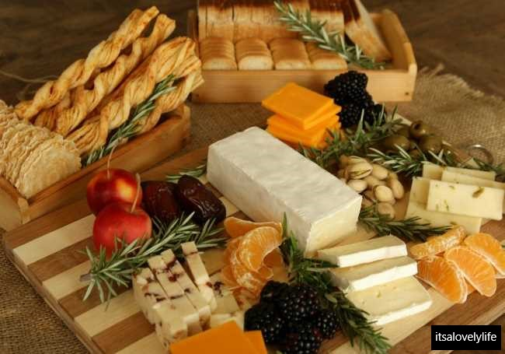
Platters

Slide 18
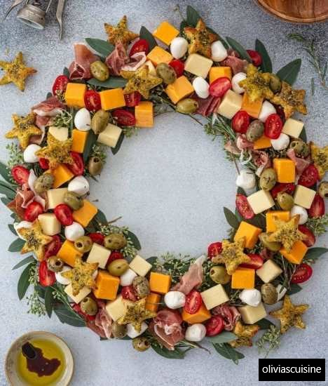
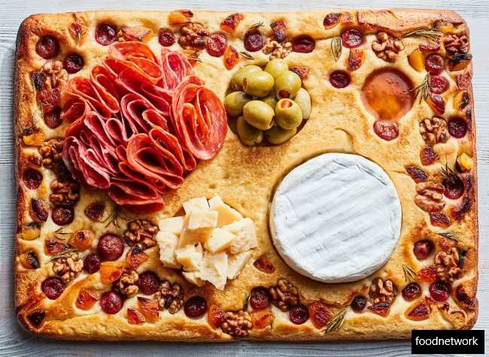
Platters

Slide 19
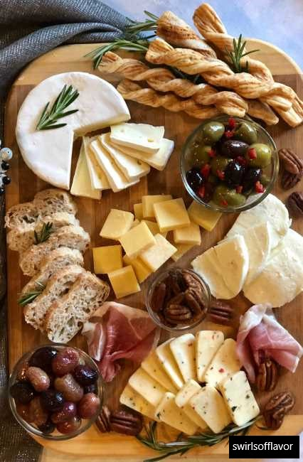
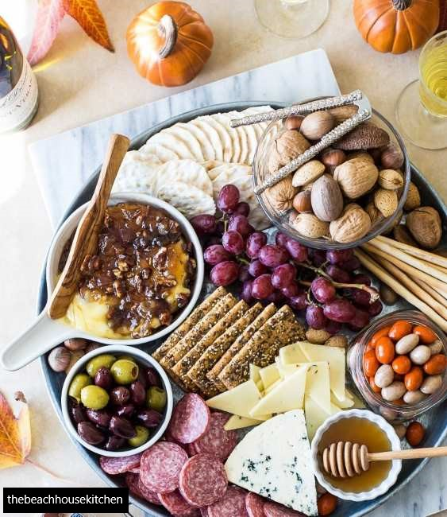
Platters

Slide 20
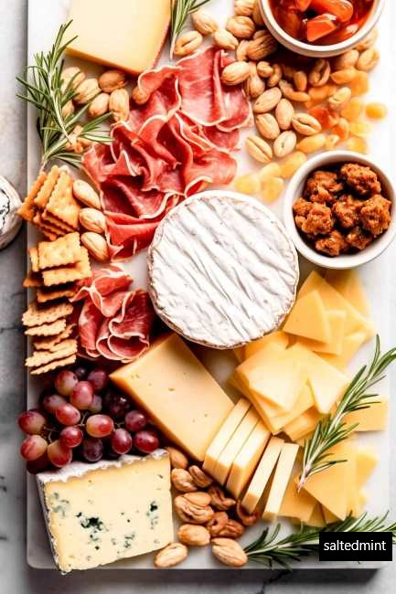
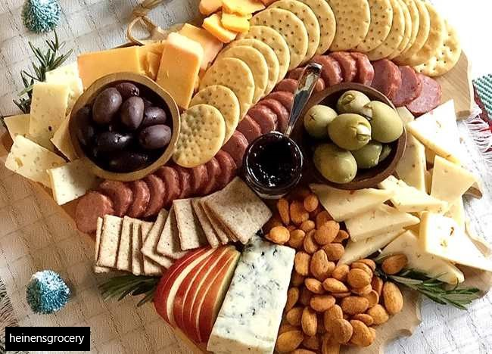
Platters

Slide 21
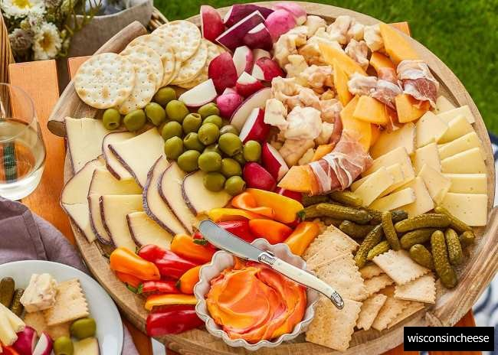
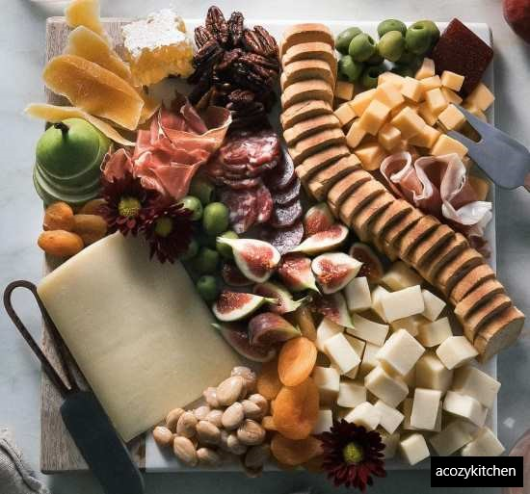
Platters

Slide 22
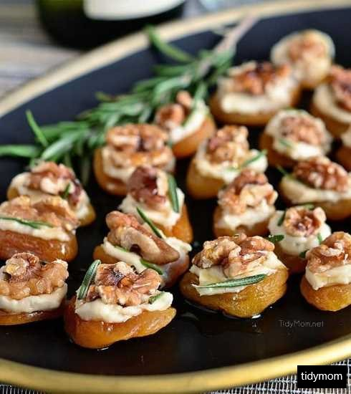
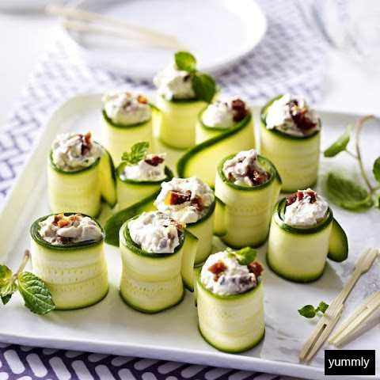
Cold Canapés
Olive and Cream Cheese Cucumber Wraps
Apricot and Blue Cheese with Walnuts

Slide 23
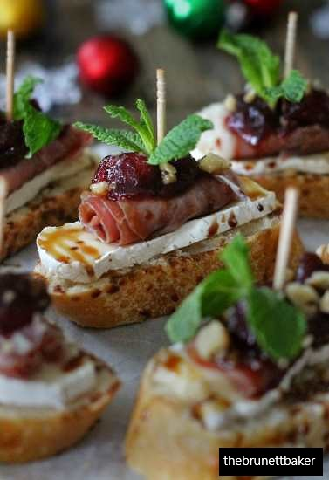
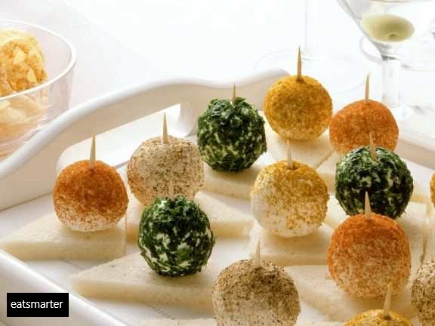
Cold Canapés
Cheese Balls on Tramezzino
Cranberry, Brie, and Prosciutto

Slide 24
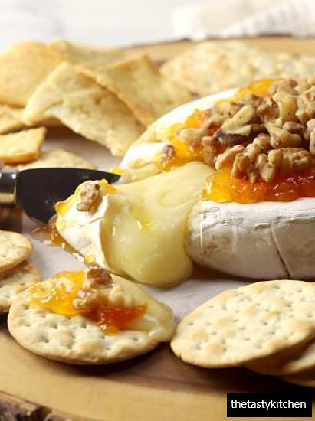
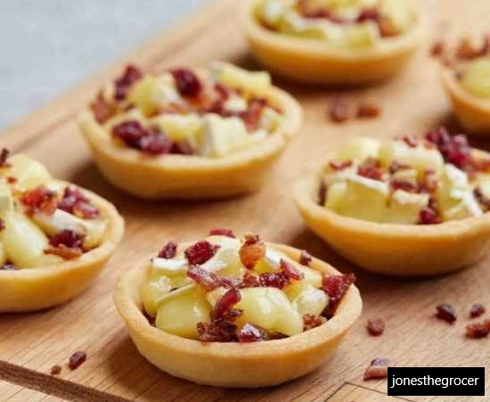
Hot Canapés
Baked Balsamic Bruschetta
Roasted Shallot and Goat Cheese

Slide 25
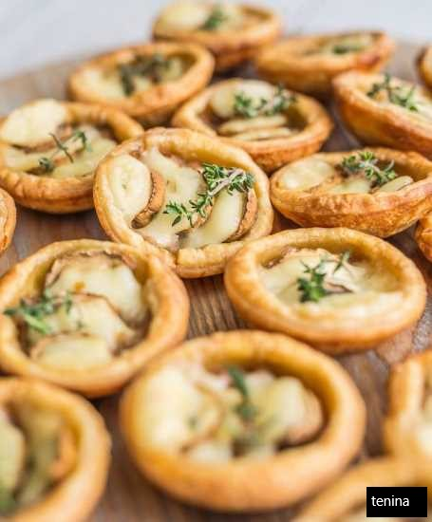
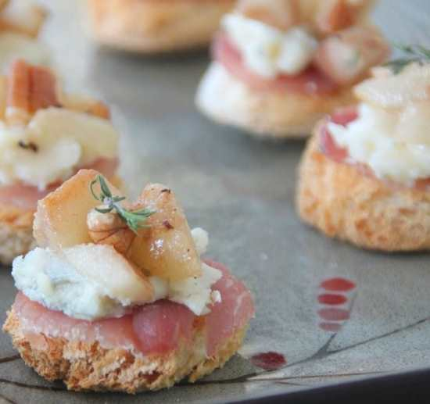
Hot Canapés
Roasted Pears, Prosciutto, and Gorgonzola
Swiss Cheese and Mushroom Tartlets

Slide 26
Any Questions?

