Slide 1
Garde Manger
Day 3: Charcuterie

Slide 2
Learning Objectives
Define and understand the history of charcuterie.
Identify common types of sausage and prepared meats.
Learn how to put a contemporary spin on traditional hors d’oeuvre selections.
Practice creative presentation techniques suitable for buffet/ banquet operations.
Produce the assigned hot and cold canapés and charcuterie platters.

Slide 3
Key Terms
Andouille
Braunschweiger
Cervelat
Charcuterie
Chipolatas
Chorizo
Cured Meats
Dry Sausage
Landjäger
Mortadella
Pâté
Prepared Meats
Prosciutto
Scrapple
Semi-dry Sausage
Souse
Weisswurst

Slide 4
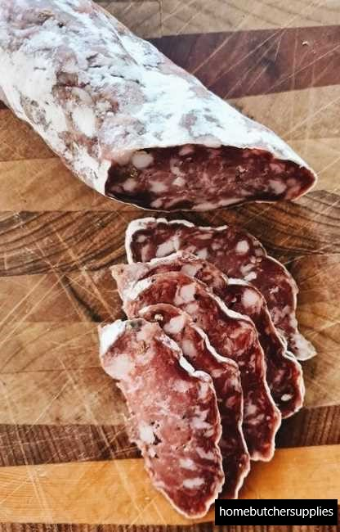
Charcuterie
From the French words chair “flesh” and cuit “cooked”
Pronounced “shar-cue-tuh-ree”
Describes cooked or cured meats, sausages, and pâtés (mostly from pork)
Also refers to a delicatessen where these meats are sold
Today the term is applied to many varieties of meat, poultry, fish, and seafood

Slide 5
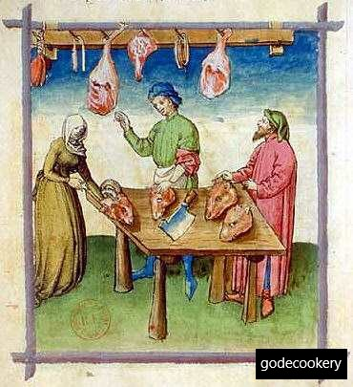
History of Charcuterie
Sausage first made by the ancient Romans, Greeks, Babylonians, and Chinese
Romans developed the art of pork butchery and salting and curing meats
By the Middle Ages, many types of sausage were produced depending on climate and spice/ seasoning availability
Southern Europe: dry and fermented sausage; Northern Europe: fresh and cooked types
Today, many different types of sausage are produced, both ethnic traditional and modern contemporary modifications

Slide 6
USDA Sausage Classifications
Group | Description | Examples
Fresh Sausages | Made of fresh uncured meat, generally cuts of fresh pork and sometimes beef; Must be kept under refrigeration and thoroughly cooked before serving | Breakfast Italian
Uncooked Smoked Sausages | Have all the characteristics of fresh sausage except they are cold smoked to give the product a different flavor and color; must be cooked before eating | Chorizo Andouille
Cooked Sausages | Unsmoked and are fully cooked, usually by poaching, and are ready to serve | Liverwurst Bratwurst
Cooked, Smoked Sausages | Cured, smoked and fully cooked, often emulsified types | Frankfurters Knockwurst
Dry and Semi-dry Sausages | Produced by fermentation due to either “Chance inoculation”, “backslopping” (natural), or an addition of a lactic acid producing culture | Salami Pepperoni
Cooked Meat Specialties | Luncheon meats, loaves, and jellied products. Items made in different shapes and forms, using various methods, also fully cooked | Leberkäse Pâtés Terrines

Slide 7
Common Types of Sausage
Sausage | Description
Andouille | Pork, spicy, cured, semi-dry, medium texture (smoked, uncooked) (Sheep Casing)
Blood Sausage | Blood, spices, diced cooked pork jowls and finely ground (Cooked) meat (All Casings)
Bockwurst | Veal and pork, milk, chives, and chopped parsley, fine texture (fresh, cooked) (Sheep Casing)
Bologna | Cured beef and pork, finely ground with spices (cooked, smoked) (Beef Bologna) (Beef Middle or Beef Bung)
Bratwurst | Pork or pork and veal, seasoned, fine emulsified or fresh cooked, or medium-grind textures, cured, smoked (Smoked Bratwurst, Cooked Sausage) (Hog Casings)– German (Sheep Casing)- Swiss
Braunschweiger | Liver, meat, smoked meats, fine grind (cooked) (Beef Middle to Beef Bung)
Breakfast | Pork, seasoned, fine to medium grind (fresh) Links or patties (seasoning variations) (Sheep Casing)

Slide 8
Common Types of Sausage
Cervelat | Pork, beef and pork, medium to coarse grind, mildly seasoned, (semi-dry) cured, smoked (Beef or Hog Middle)
Chipolatas | Pork or pork and veal, mildly seasoned, very fine emulsion (cooked) mousse-like texture (Sheep casing)
Chorizo | Pork, coarse texture, highly spiced, cured, smoked (smoked uncooked) (Hog Casing)
Frankfurters | Beef and pork or all beef, seasoned, cured, smoked, cooked, (cooked, smoked) fine emulsified texture (Sheep Casing)
French Garlic | Cured pork , finely diced fat, spices and predominant garlic (cooked, smoked) flavor, cooked, smoked (Beef Middle)
Head Cheese, Souse | Cured, cooked, diced pork head meat in concentrated jellied (cooked meat specialty) stock, flavored with vinegar, garnished with pickles, pimentos, parsley
Italian | Pork, coarse grind, seasoned (fresh) Hot--highly seasoned, Sweet--mildly seasoned (Hog Casing)
Kielbasa | Pork or pork and beef, fine emulsified and medium texture (uncooked, cured) (cooked, smoked) (Beef Round)

Slide 9
Common Types of Sausage
Knackwurst | Beef and pork or all beef, seasoned, cured, smoked, cooked, (cooked, smoked) fine emulsified texture (Hog Casing)
Landjäger | Pork and beef, medium texture, cured, dried, flattened (Hog Casing)
Leberkäse | Bologna mix, beef and pork or sometimes with veal, baked in a loaf pan; Bavarian Loaf
Liverwurst | Liver, meat, smoked meats, fine grind (cooked) Swiss Hildsheimer (Beef Middle to Beef Bung)
Mortadella | Pork, fine emulsified with garnish such as diced fat and pistachios (cooked) (Beef Middle or Bung Cap)
Salami | Pork or pork and beef, cured, highly seasoned with dry-fermented flavor, air dried, medium texture (Beef Bung Cap, Artificial Casing, Beef Middle)
Scrapple | Ground cooked pork, cornmeal, made into loaves or bricks (cooked meat, made in loaf pan) (specialty)
Tuscan | Pork coarse grind, seasoned with cheese and tomatoes (fresh or cooked) (Hog Casing)
Weisswurst | Pork and veal, mildly seasoned, fine emulsified texture (cooked) White sausage (Sheep of Hog Casings)

Slide 10
Common Types of Prepared Meats
Meat | Description
Bacon | Cured, smoked, pork belly
Canadian Bacon | Cured, smoked, fully cooked boneless pork loin
Smoked Pork Butt | Cured, smoked, fully cooked cottage butt
Corned Beef | Cured beef brisket or bottom round
Ham, cooked | Cured, molded, fully cooked ham, Boiled ham
Ham, smoked | Cured, smoked, fully cooked
Pastrami | Cured, beef plate, rubbed with spices and smoked/baked
Prosciutto | Dry cured ham, flattened
Smithfield Ham | Dry-cured ham from peanut-fed hogs, from Smithfield, Virginia

Slide 11
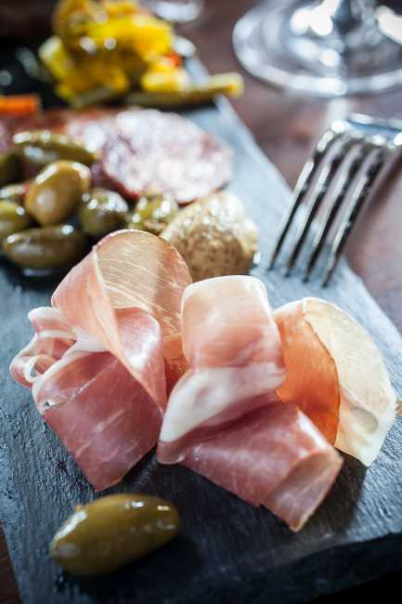
Platters: Presentation and Layout
To produce a pleasing physical layout, remember to consider the following:
Balance
Focal Point
Visual Lines
Flow and Sequencing
Unity
Height
Shape
Color
Texture

Slide 12
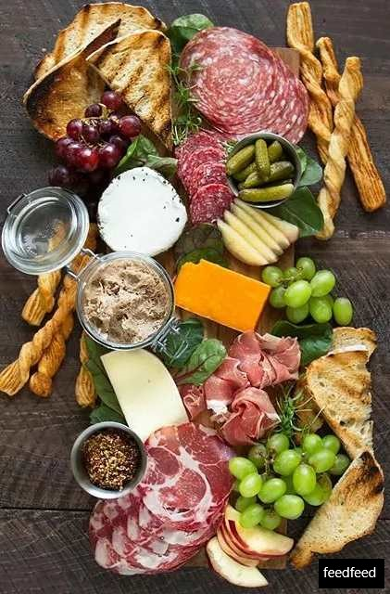
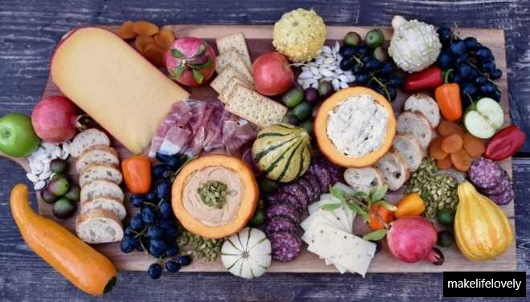
Platters

Slide 13
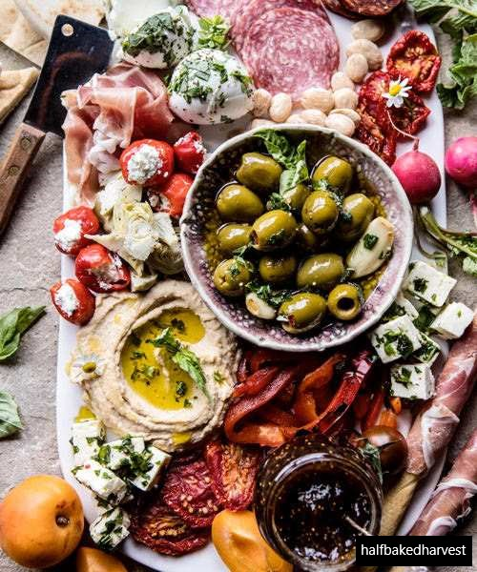
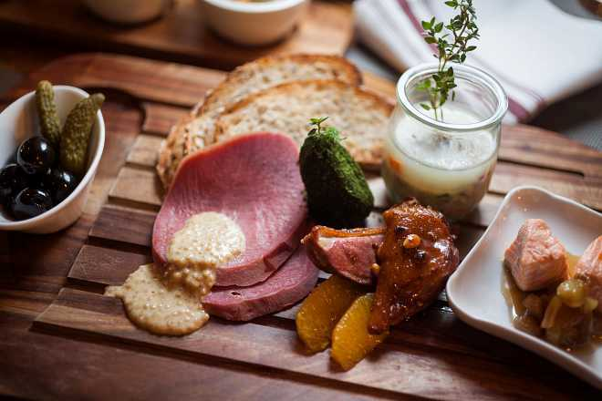
Platters

Slide 14
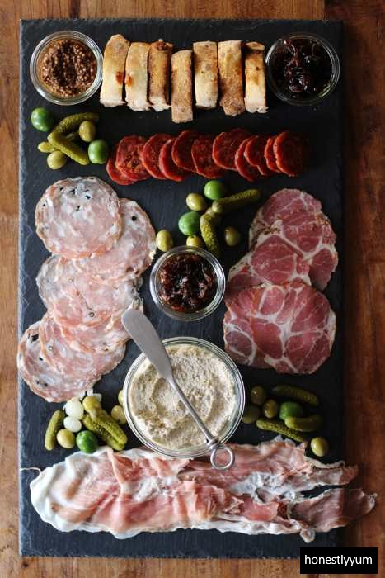
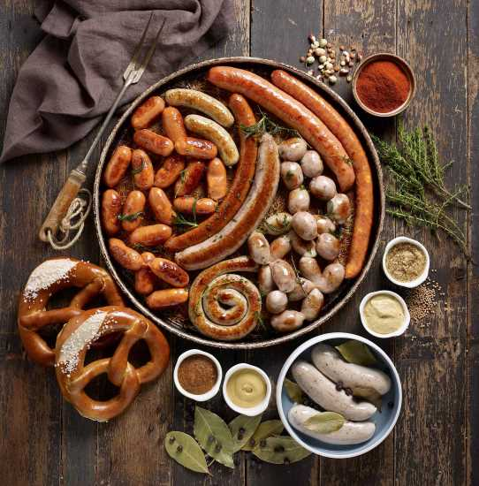
Platters

Slide 15
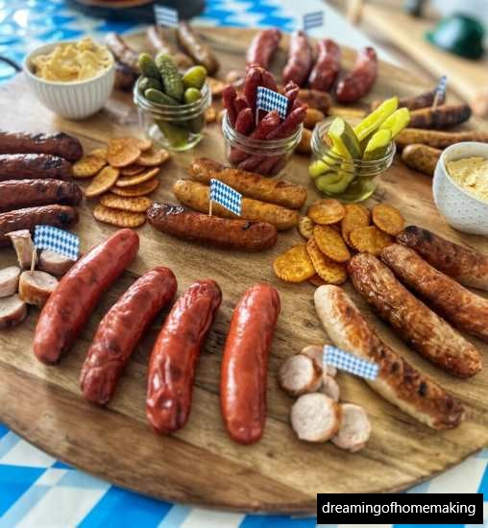
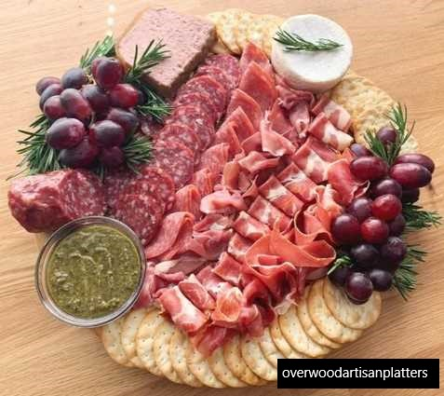
Platters

Slide 16
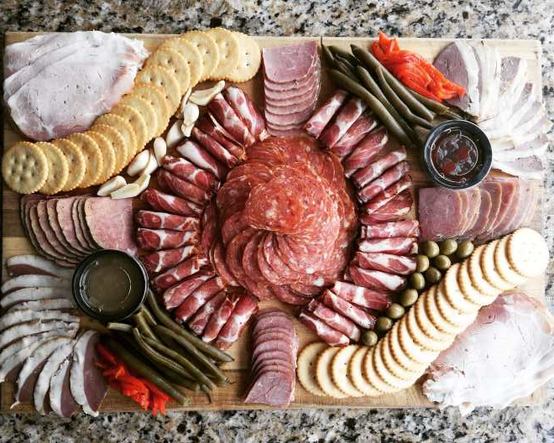
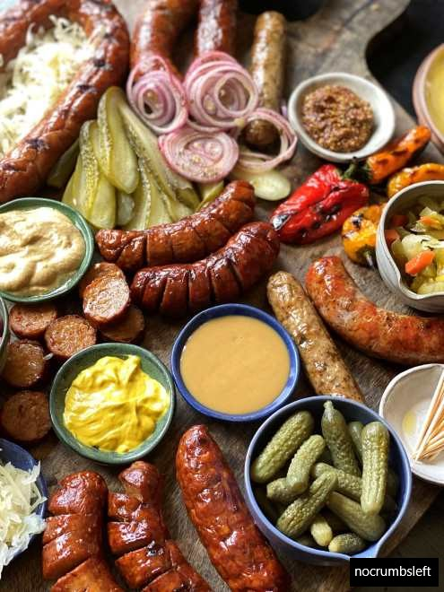
Platters

Slide 17
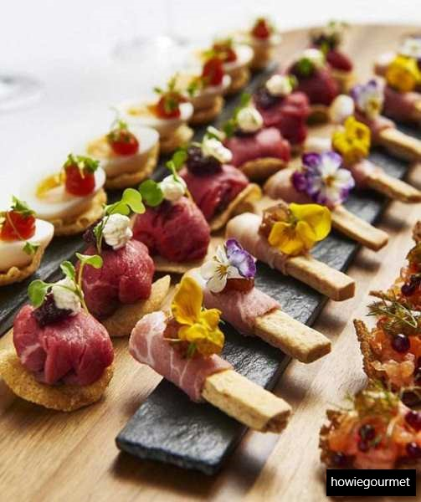
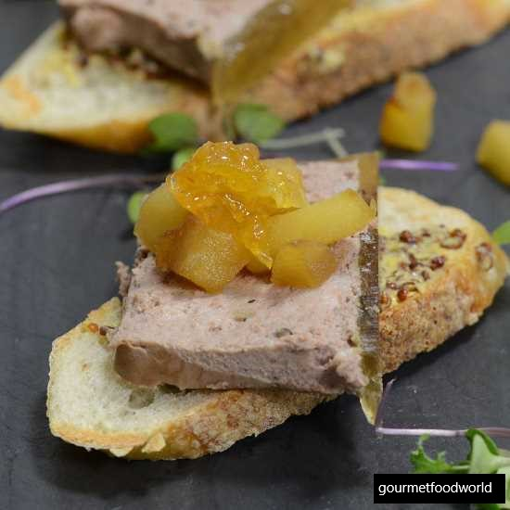
Cold Canapés
Pâté, Apple, and Chutney
Chicory Babaganoush with Pomegranate

Slide 18
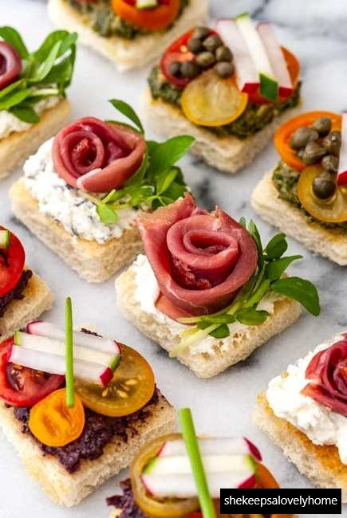
Cold Canapés
Salmon Mousse
Tapenade, Pesto, Prosciutto Rose

Slide 19
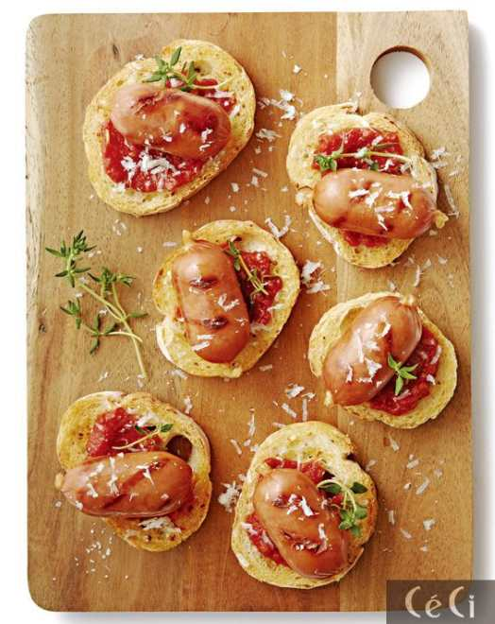
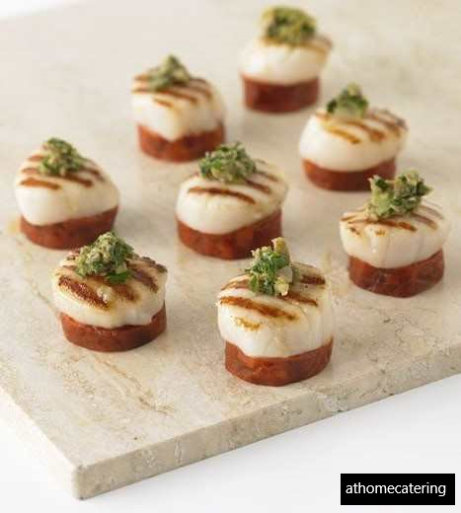
Hot Canapés
Baked Balsamic Bruschetta
Roasted Shallot and Goat Cheese

Slide 20
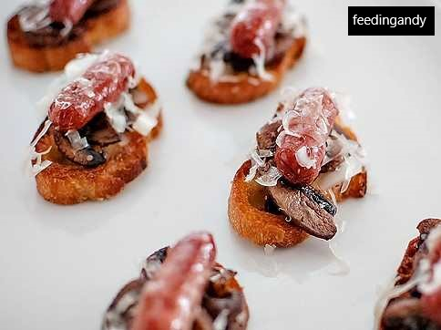
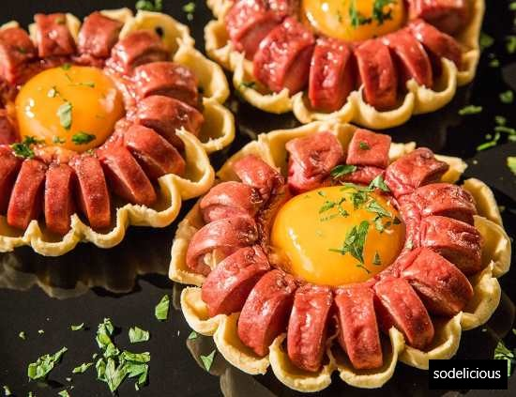
Hot Canapés
Sausage and Mushroom
Puff Pastry Vienna Sausage Flowers

Slide 21
Any Questions?

